Slide 1
FOREX Rate Prediction
Capstone Project
Abhinav Pandey

Slide 2
Dataset
Available in the form of a csv file. Source - https://www.rba.gov.au/statistics/historical-data.html
Contains daily exchange rates of 35 currencies against the Australian Dollar (AUD), including USD, JPY and GBP from Jan 1984 to Feb 2020.

Slide 3
Recap
Stationarity of Time Series
Using Machine Learning models

Slide 4
Using transformations to make the dataset stationary
1. Log Transform
2. Square Root Transform
3. Proportional Change Transformation
4. Log Returns
5. First Differencing (Returns)

Slide 5
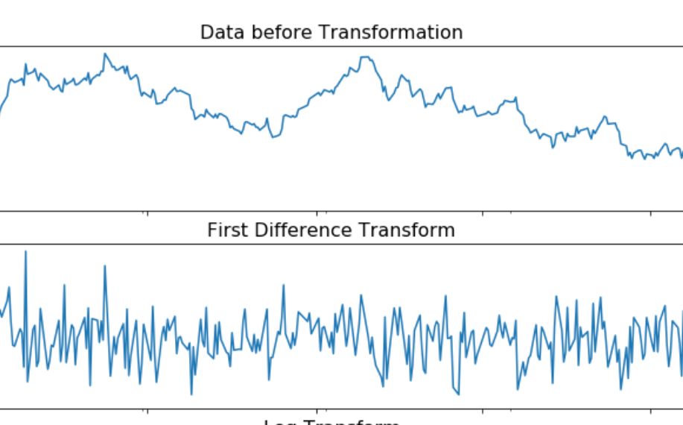
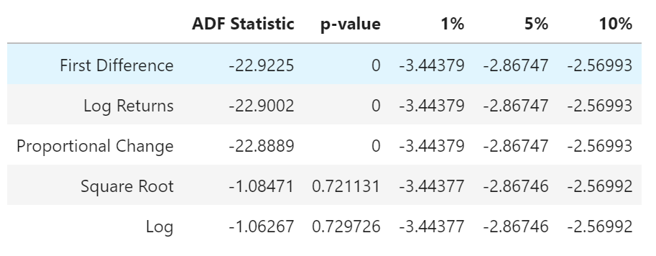
ADF Test of the Transformation Results

Slide 6
Recap
Stationarity of Time Series
Using Machine Learning models

Slide 7
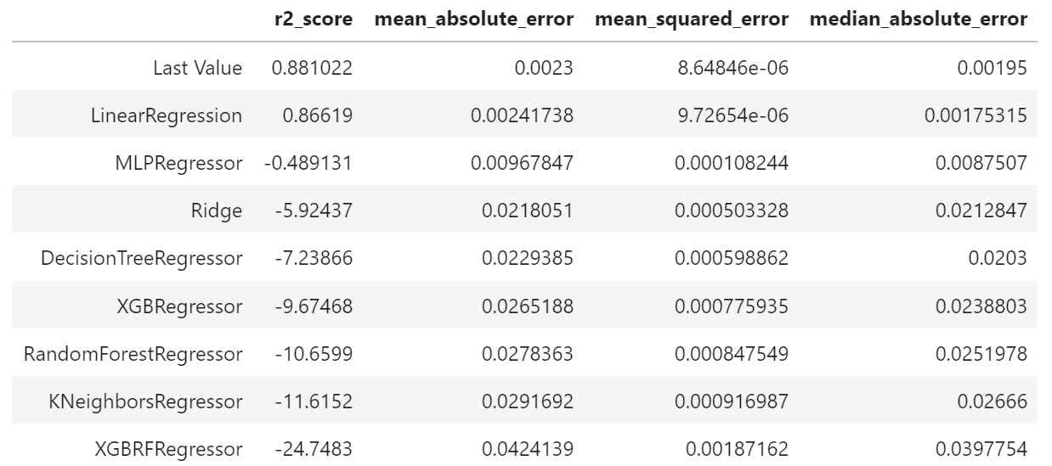
Past 10 days of FOREX rates to predict one day into the future

Slide 8
Updates
Defining a new evaluation metric: PROFIT!

Slide 9
The Profit Metric
If we BUY every time our forecast says that the price is going to increase and SELL every time our forecast says that the price is going to fall, can our model give us returns better than random?
Still unclear? Let me explain

Slide 10
The Profit Metric
If we BUY every time our forecast says that the price is going to increase and SELL every time our forecast says that the price is going to fall, can our model give us returns better than random?
Still unclear? Let me explain

Slide 11
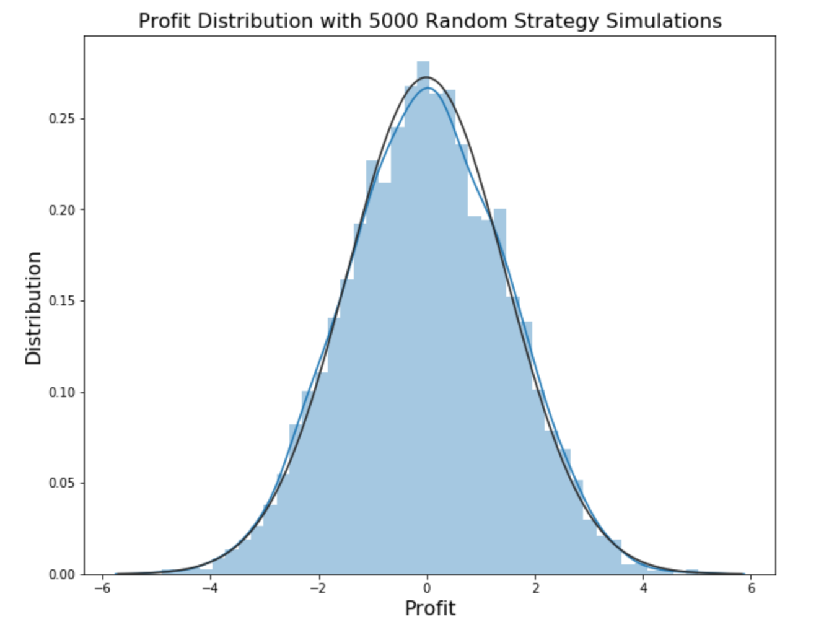
The Profit Metric
We evaluate a model’s performance with the main metric as PROFIT (followed by R-squared, MAE, MAPE, etc. for models with similar profit returns).
What is the best a forecasting model can achieve with the naïve strategy?

Slide 12
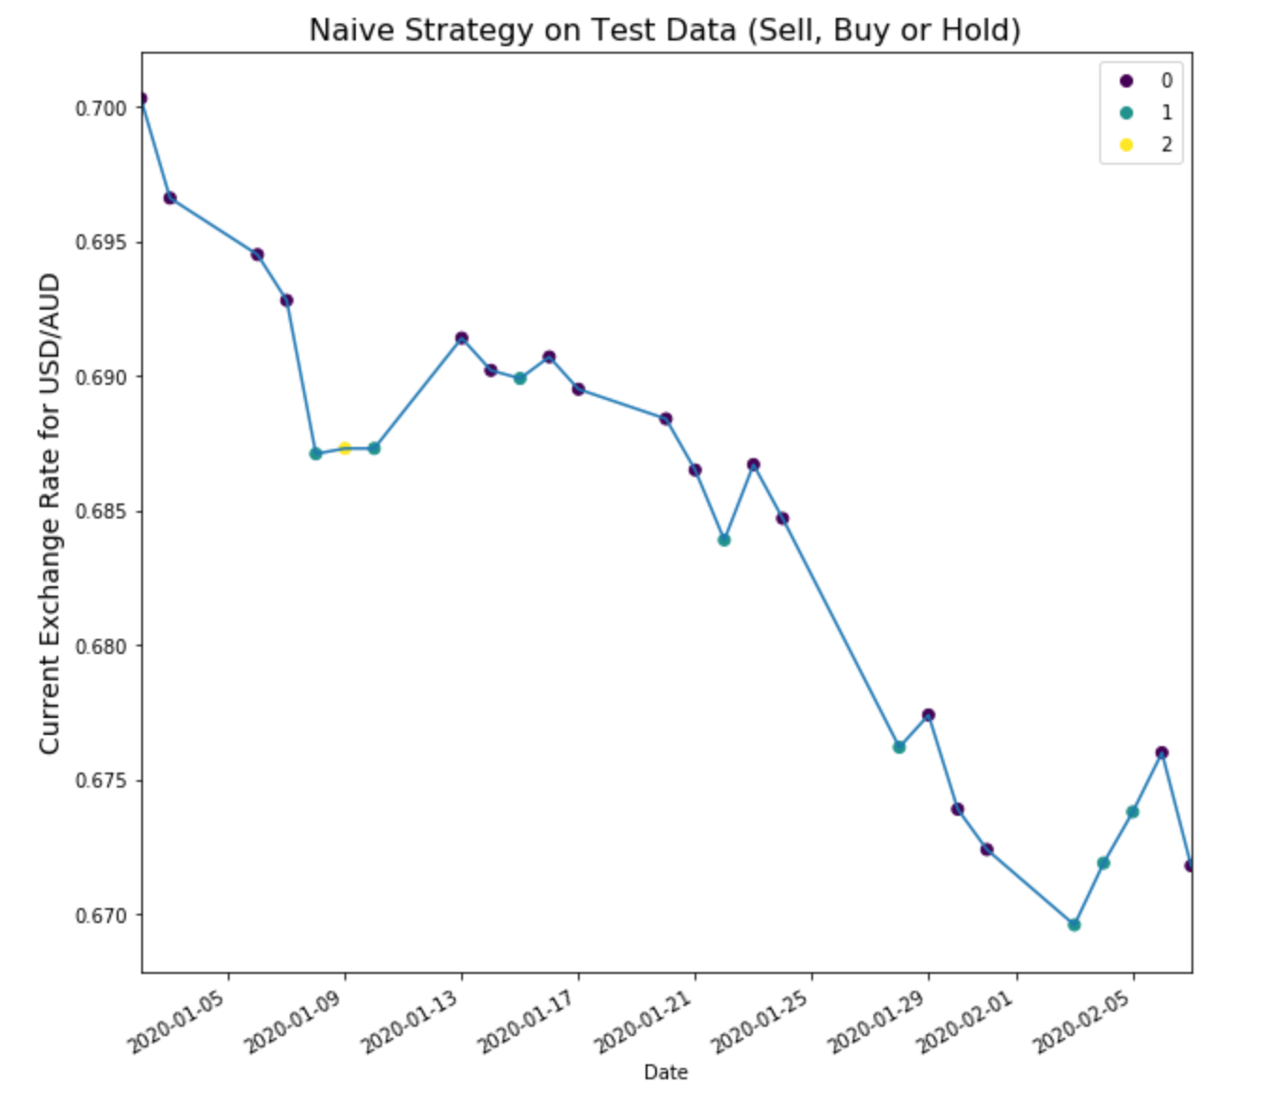
Example with Testing Data
0 = Sell
1 = Buy
2 = Neither
Buy when predicted increase.
Sell when predicted decrease.
Do nothing when no increase or decrease.

Slide 13
Example with Testing Data
What happens if we sell, buy or hold at random?
What do our profits look like?

Slide 14
Example with Testing Data
What happens if we sell, buy or hold at random?
What do our profits look like?
Roughly equal to a Gaussian Distribution centered at 0 PROFIT.
Implies roughly 50-50 chance of profit/loss.

Slide 15
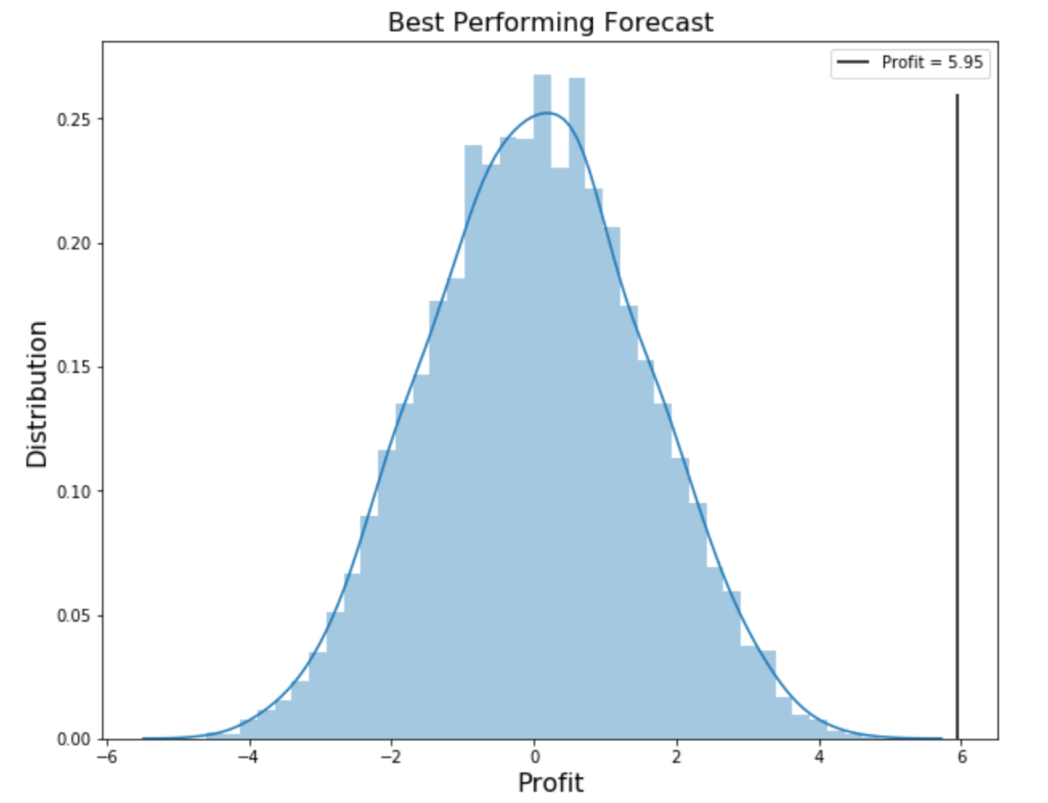
The Profit Metric
Profit = 5.95!
Let me show you what that’s worth.
Simulation details :
Trade size = A$100 / trade
FOREX Market Leverage = 1 : 50
Profit equivalent :
5.95 x 50 = A$297.5 (in 25 days)
A$11.5/day for every A$100 invested

Slide 16
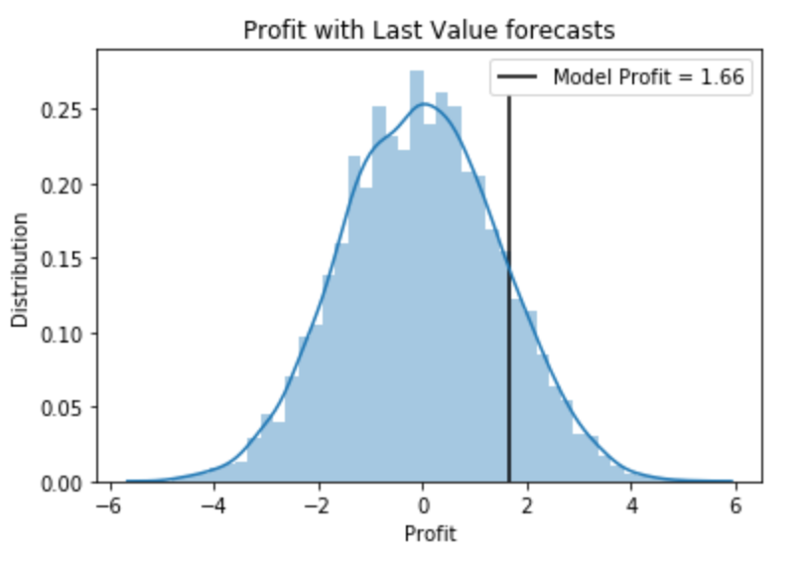
Back to the Last Value Model
R-squared = 88.1%

Slide 17
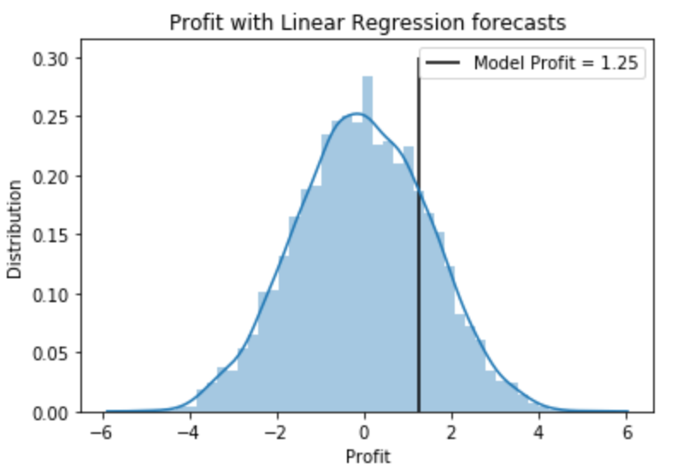
Linear Regression Model
R-squared = 86.62%

Slide 18
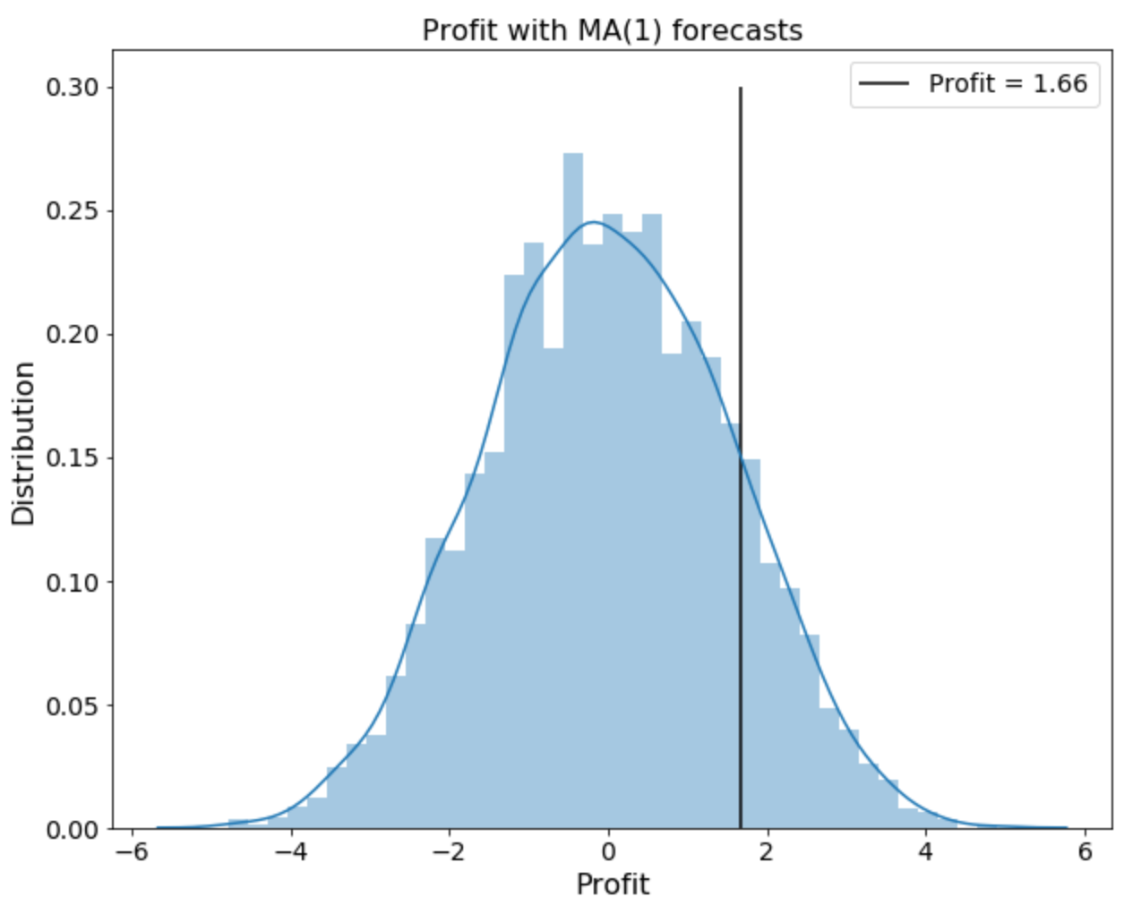
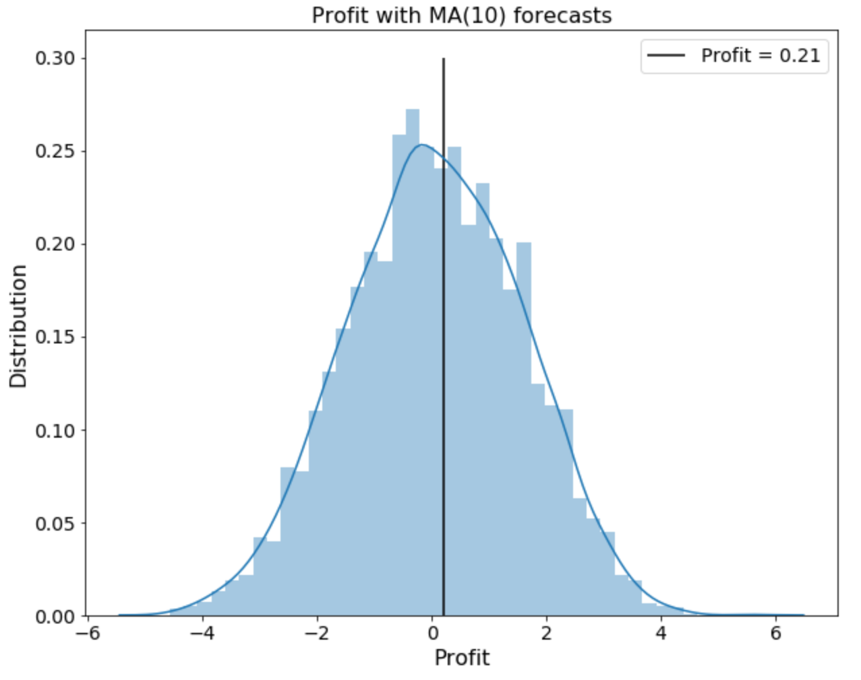
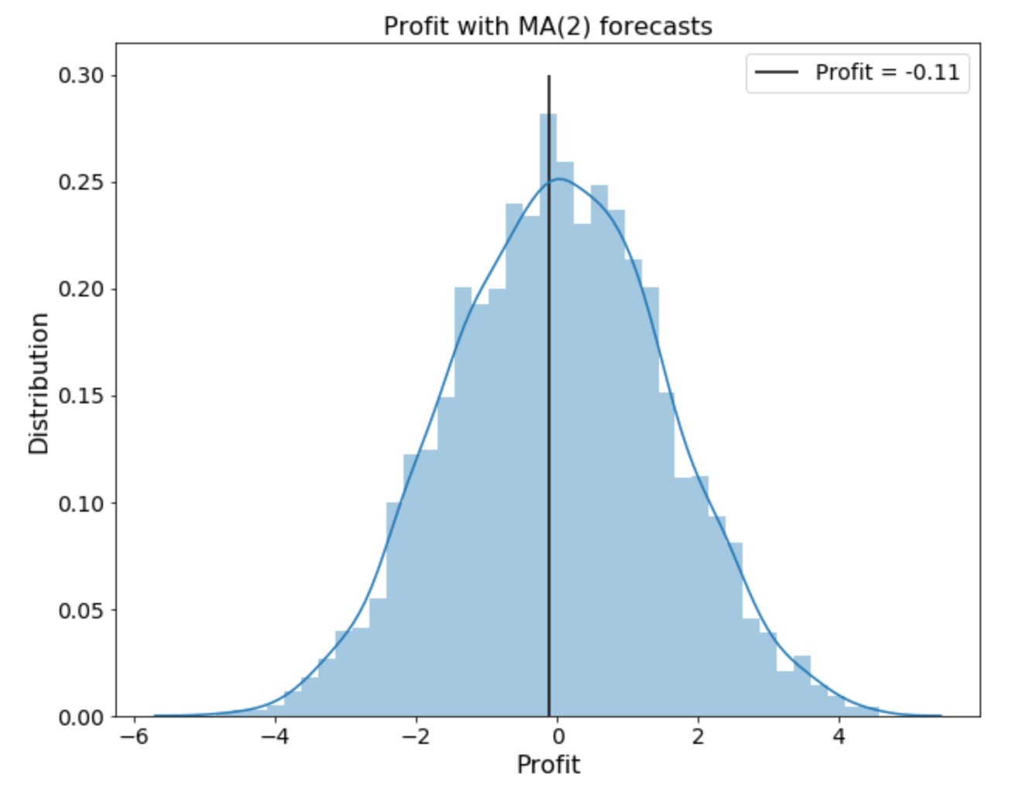
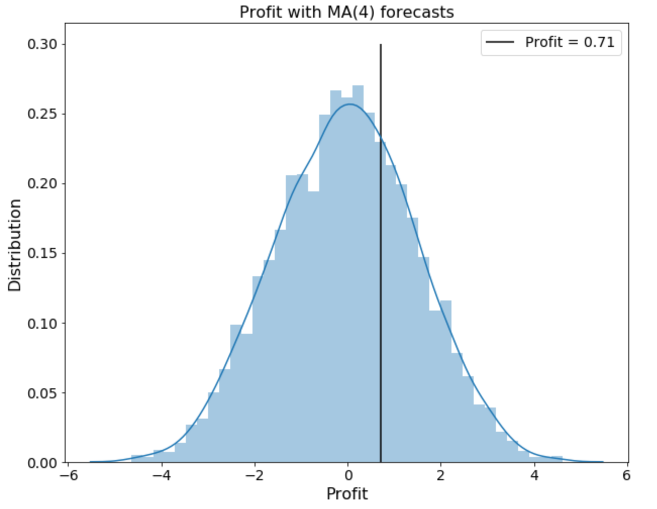
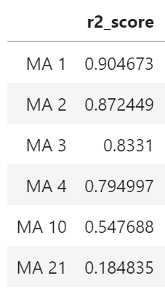
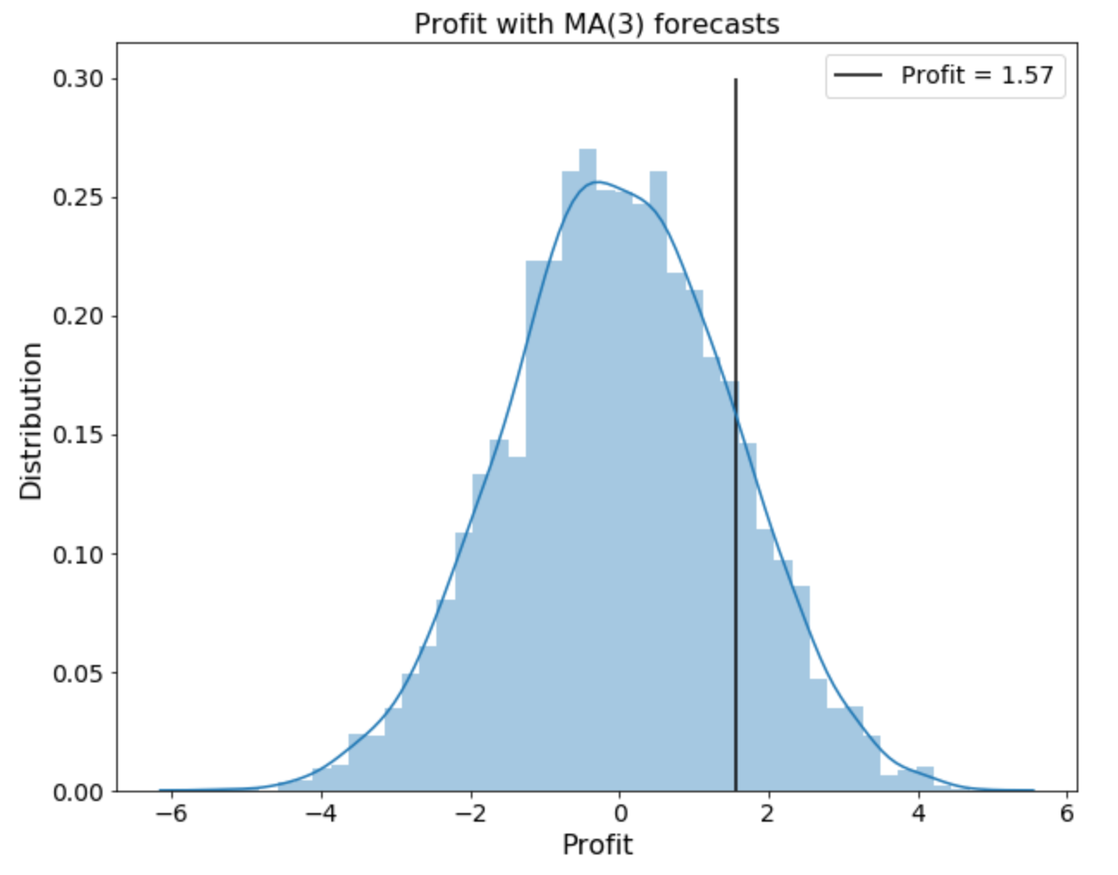

Moving Average Models

Slide 19
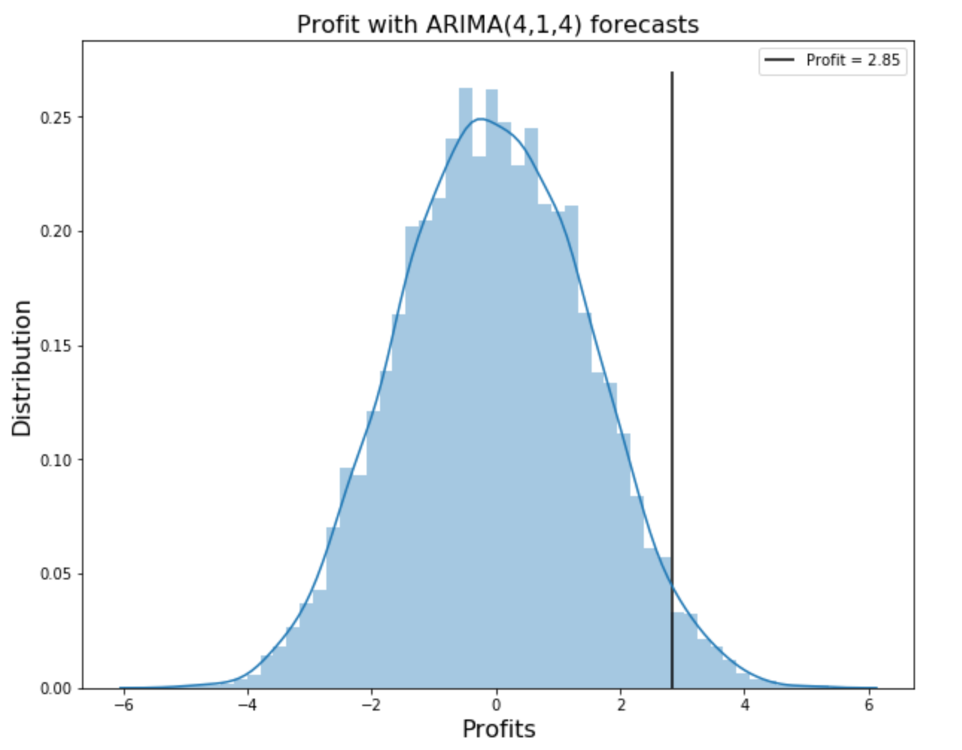
ARIMA(4,1,4) Model
R-squared = 80.32%

Slide 20
Current Standings
ARIMA(4,1,4)
Last Value (Benchmark)
Linear Regression

Slide 21
Next Steps
Cross-validate profit findings : Verify the robustness of the ARIMA model’s performance by checking model’s profit returns for multiple different 25 day periods in the last 3 years.
Model and evaluate new models (RNN, LSTM and Prophet)
Add time features(day, month, etc.) and seasonal effects using seasonal decomposition and check effect on model performance.

Slide 22
Questions?

